Slide 1

AIRBNB HOST ASSISTANT
Neha Gupta

Slide 2
INTRODUCTION
Airbnb host
House listing
Yield (Revenue per year)

Slide 3
PROBLEM STATEMENT
Evaluate the listing description
Estimate revenue from description

Slide 4
METHODOLOGY
Data Gathering
Data Uploading
Data Cleaning
Exploratory Data Analysis
Text Processing
Topic Modeling
Supervised Modeling
Web App

Slide 5
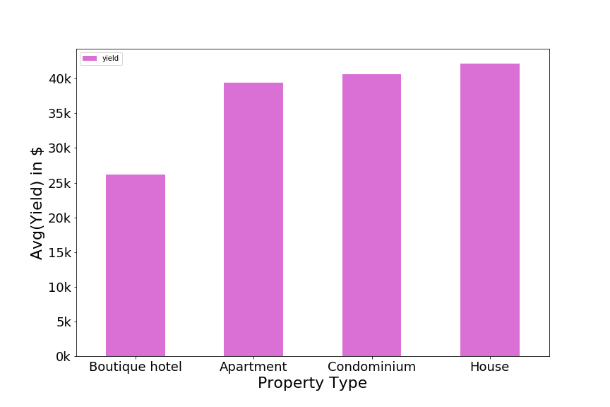
EDA

Slide 6
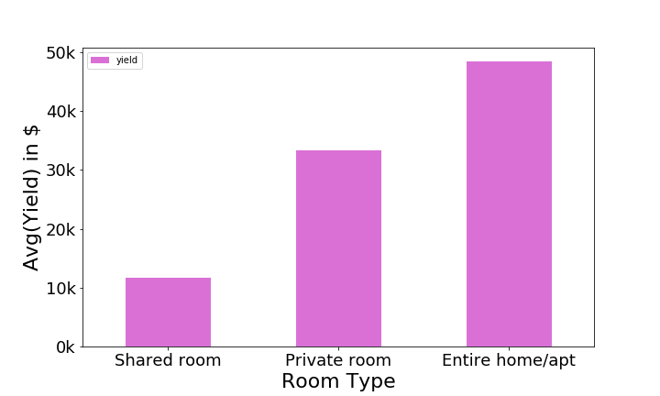

Slide 7
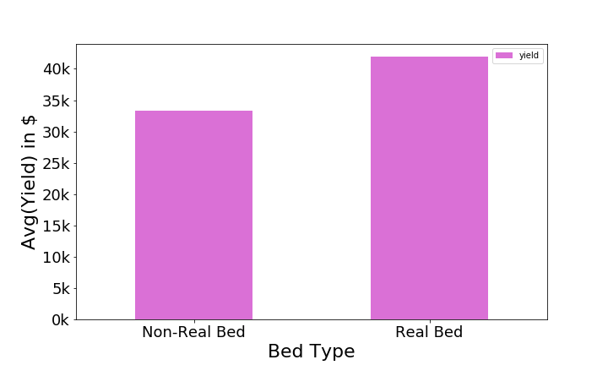

Slide 8


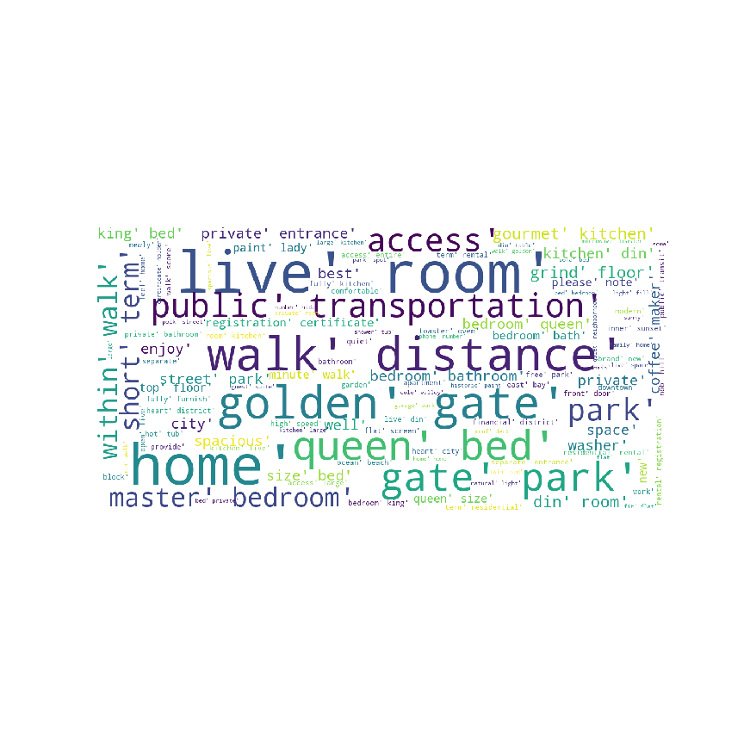



WORD CLOUD

Slide 9
TOPIC MODELING
LDA with Gensim:
Room: home,room,kitchen,bedroom,live,apartment,large,enjoy,modern,city"
•Neighbor: park,walk,street,gate,golden,neighborhood,downtown,distance,close,block
House: room,private,bed,bathroom,bedroom,queen,entrance,access,space,kitchen

Slide 10
Supervised Models
Model | R2 Score | RMSE Score
Linear Regression | 0.33 | 53167.27030
Decision Tree | 0.18 | 58631.09619
Random Forest | 0.47 | 47070.98550

Slide 11
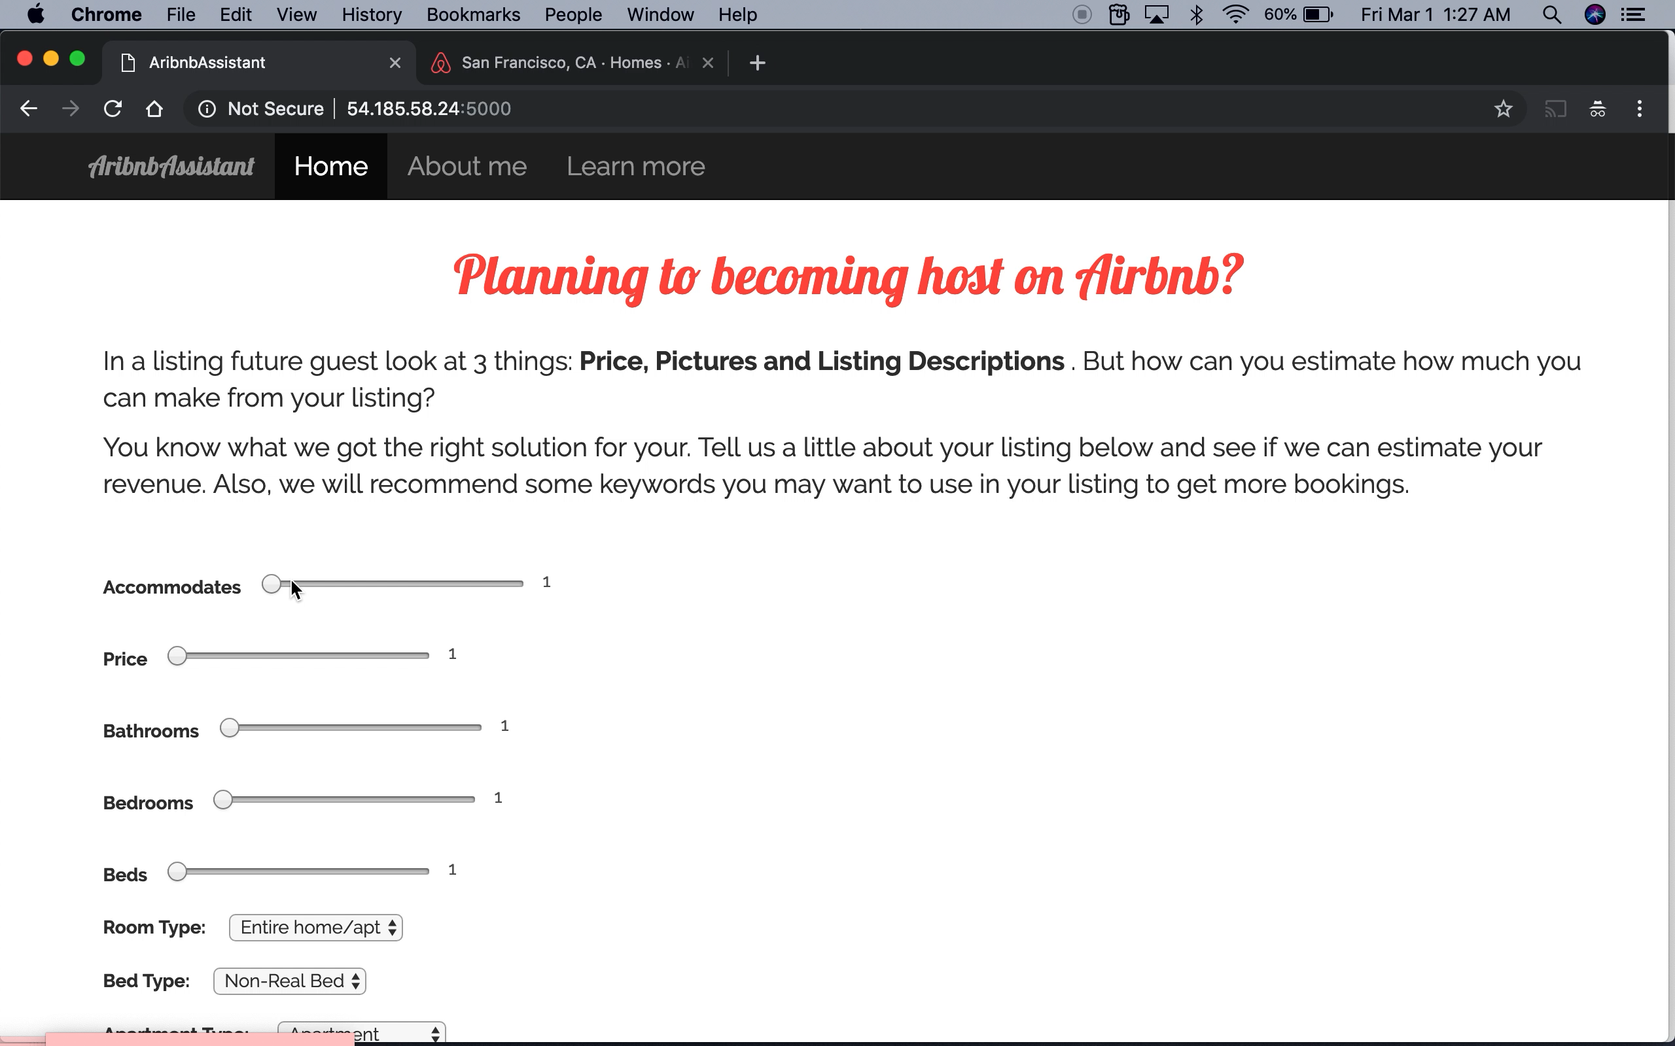

Slide 12
Future Work
Improve the app for better recommendation
Include seasonality

Slide 13
Thank You!!

